Slide 1
lisov@alexEY:~$ Hello, Today I want to tell you about wifi, working principles, hacking methods, and of course protection

Slide 2
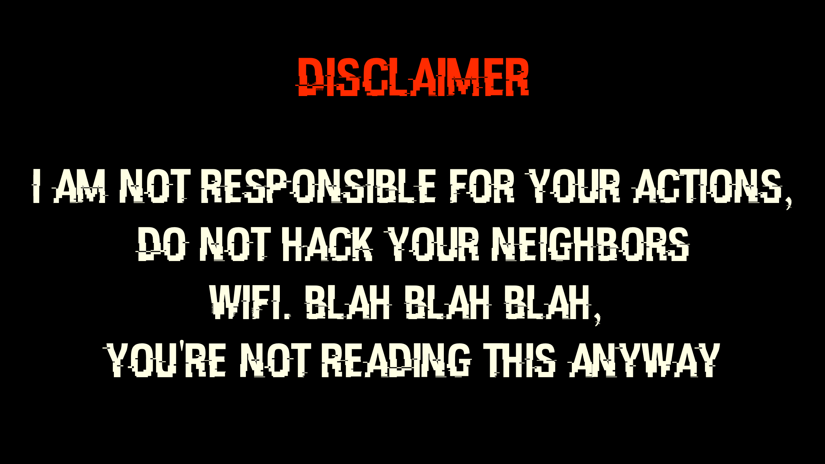

Slide 3
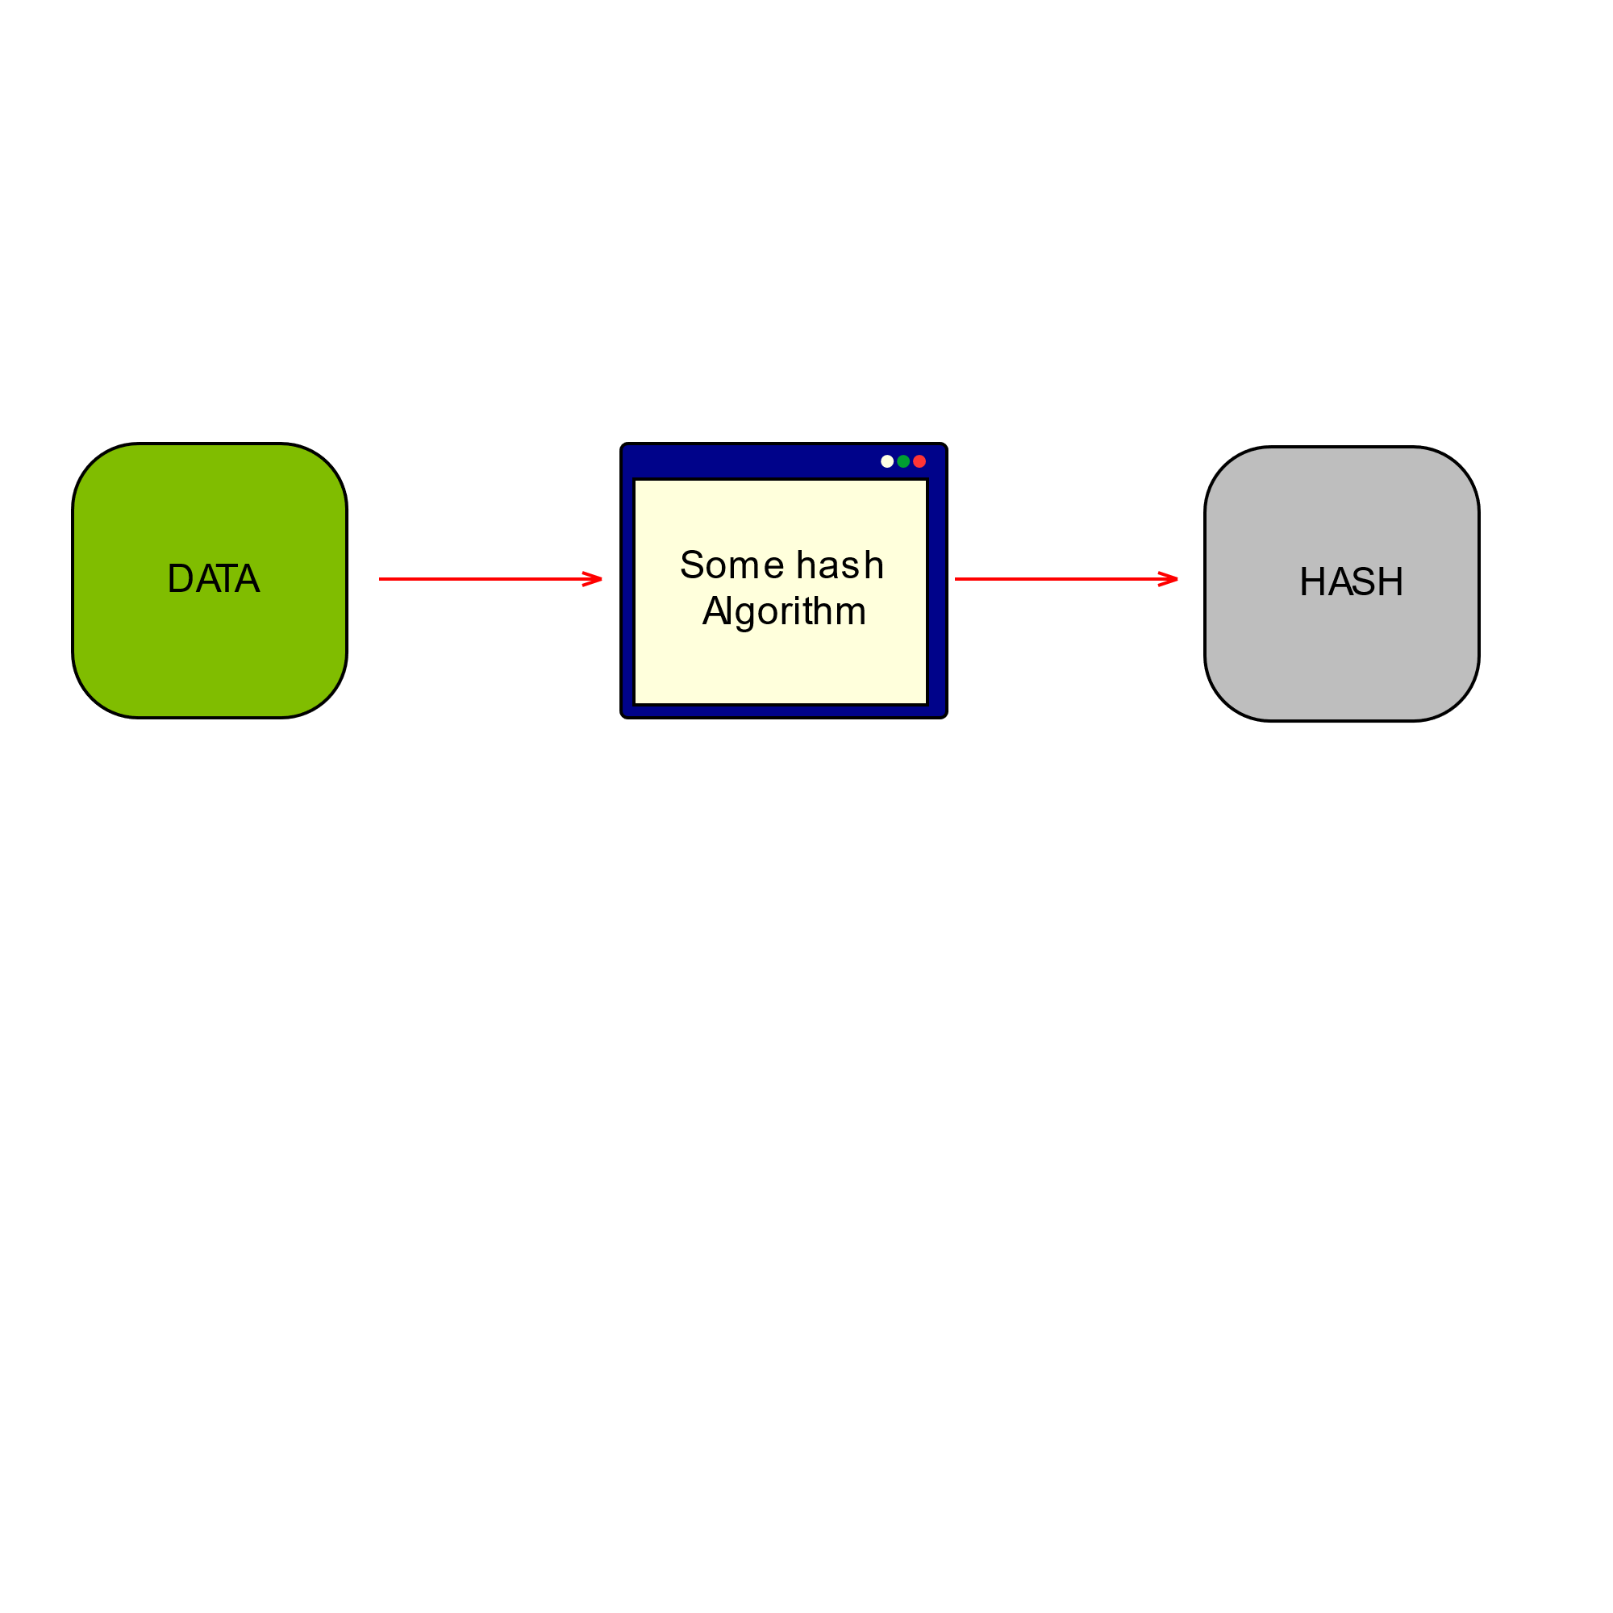
What is a hash?

Slide 4


Examples

Slide 5
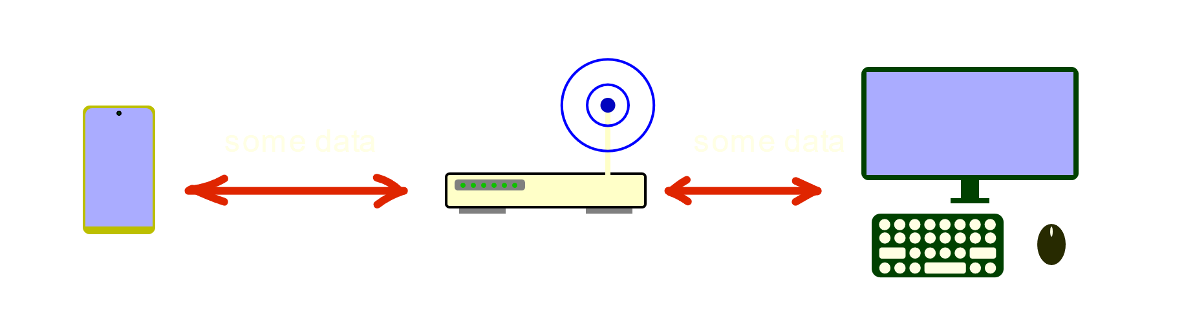
transfer

Slide 6
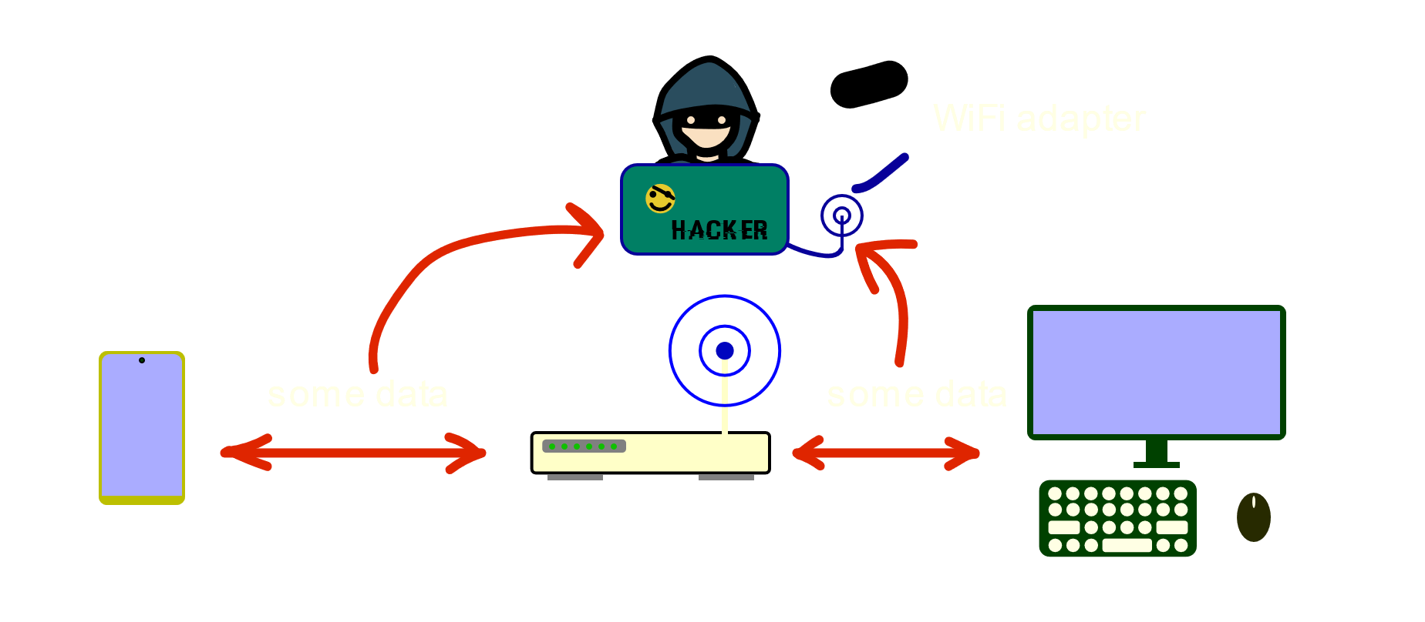
Man-in-the-middle

Slide 7
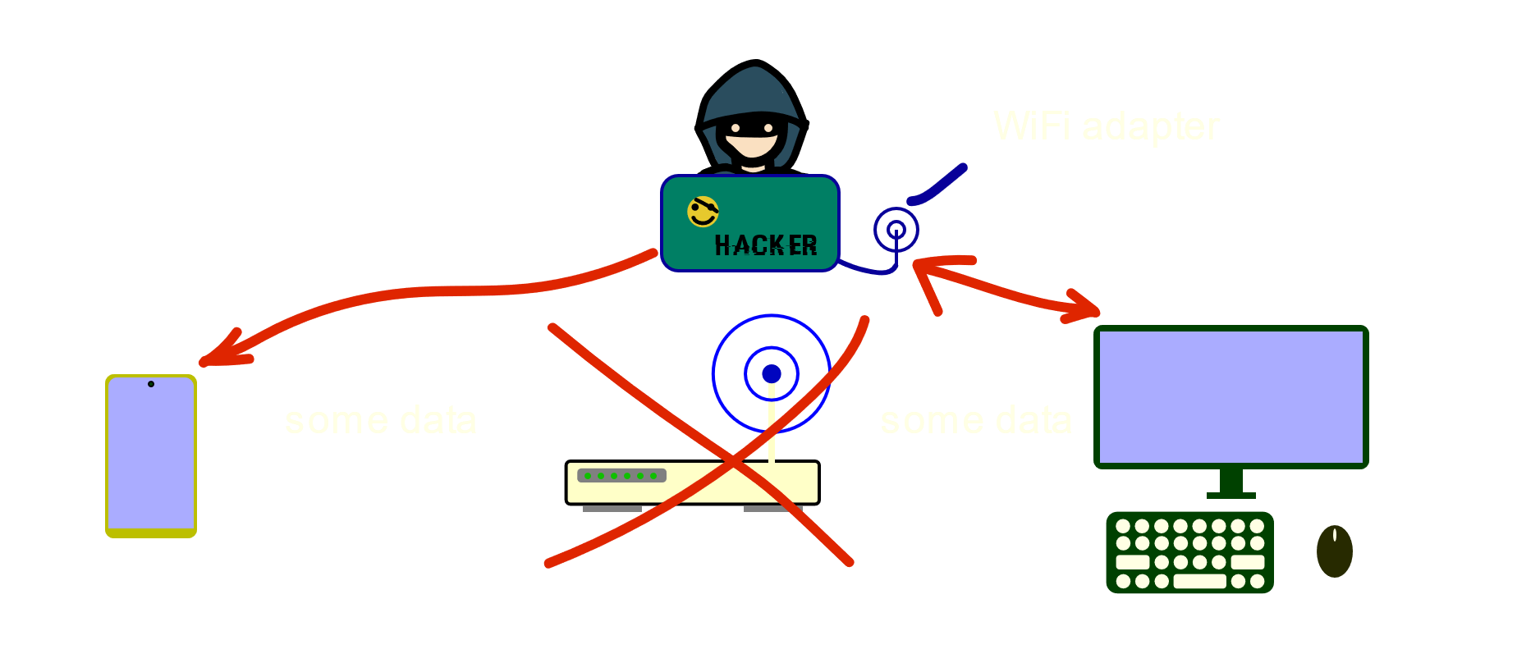
COPY POINT

Slide 8
DEFENCE
Do not use the WIFI :D
Set the hard password to your WiFi point
Change the password on admin panel of your router
turn off WPS

Slide 9


admin panel

Slide 10
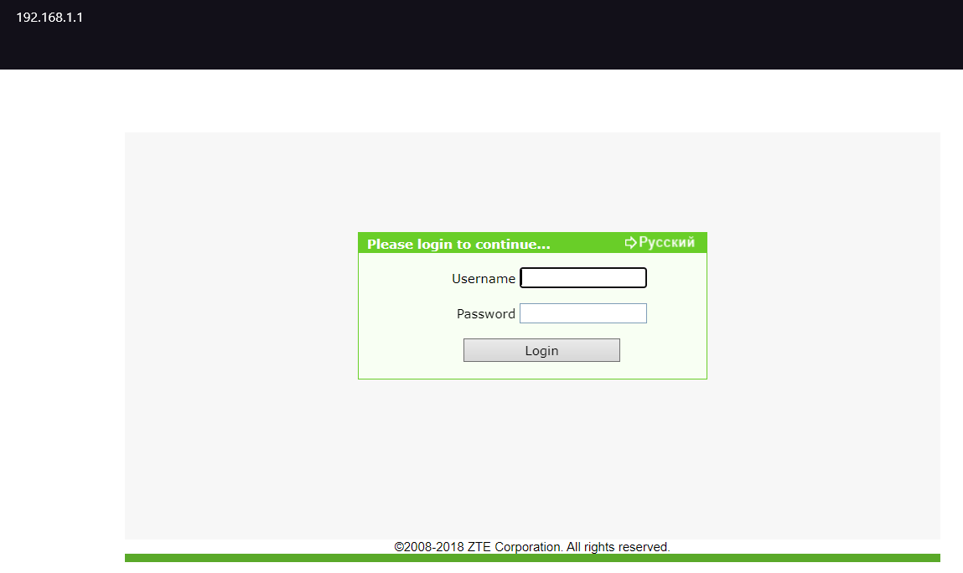

Slide 11
Goodbye. . . . . . . .

